Slide 1
Air Pollution and its effect on Mortality
SANA NAZ & AKUL S. MALHOTRA
STAT 627

Slide 2

BACKGROUND
Air Pollution refers to the release of pollutants into the air that are detrimental to human health and the planet as a whole. (NRDC).
Excessive Quantities of harmful substances are introduced in Earth’s Atmosphere.
Common Pollutants: SO₂ , CO, NO₂ , PM_{2.5}, PM₁₀
Significant risks include Respiratory Infections, Heart Disease, Lung Cancer
Geographical Location: Aspropirgos, Greece

Slide 3
HYPOTHESIS & GOAL
PREDICTION ACCURACY
Accurate Predictions based on models
As people age, their bodies are less able to compensate for effects of presence of pollutants
Mortality cause depends on the residential area type
High Multicollinearity amongst pollutants
GOAL
INTERPRETATION
Practical Application and Generalization
Notes:
Inhalation of combination of chemical compounds causes chronic diseases
evaluate the long-term association of the major air pollutants (PM₁₀, SO₂, NO, O₃, and NO₂) with respect to mortality in Greece. T

Slide 4
TIMELINE & PROCESS - DATA EXPLORATION & MODELING
Data Acquisition
Data Exploration
Data Preparation
Feature Engineering
Model Selection
Model Training
Hyperparameter Tuning
Predict & Infer
Deploy &
Manage
DataOps
MLOps
AIOps
70%
20%
10%
Dependent Variable:
Cause: Neoplasm, Circulatory, Liver, Respiratory, Other
Predictors:
Gender
Age
Area
Pollutants: NO, NO2, 03, PM10, SO2
…Monitor, Refine. and Iterate
Notes:
Concentration of PM₁₀, SO₂, NO₂, NO and O₃ in Greece, on a daily basis, from the year 2013 till the 2018
Mortality: Mortality has been classified from 1 to 16 based on codes provided by ICD 2016.
Residential Area: The areas have been coded from 1 to 6. Each number classifies area under air quality investigation.
Age: This feature provides information about age at which people died in a particular year.

Slide 5
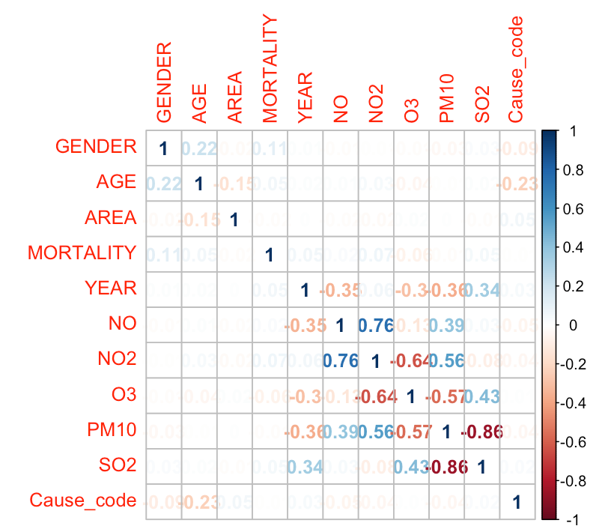
IMPEDIMENTS
No information on relationship between Area and Pollutant Concentration
No information about mortality dates
Inability to join/merge datasets*
High Multicollinearity amongst pollutants
Condition Index: 19,688
Notes:
Average concentration per year
Any index greater than 30 “…indicates strong collinearity.” The IBM knowledge center calles values over 30 a “serious problem”

Slide 6
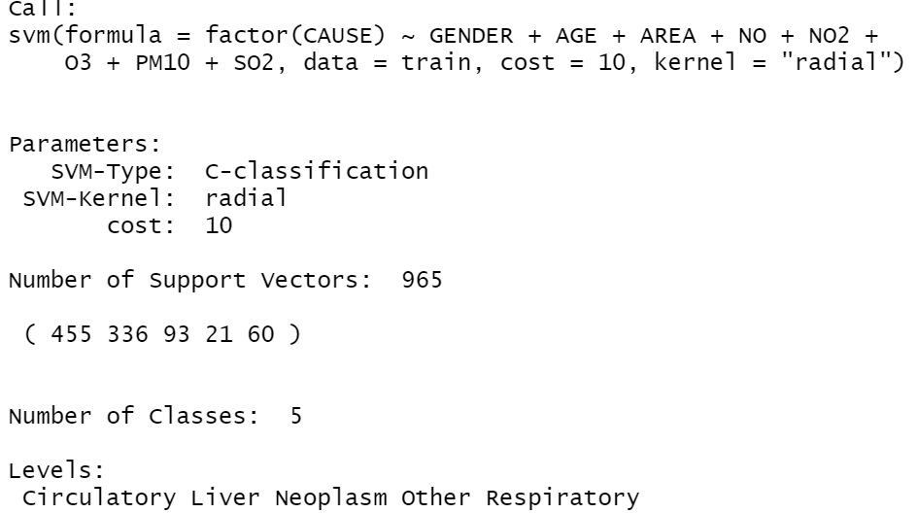
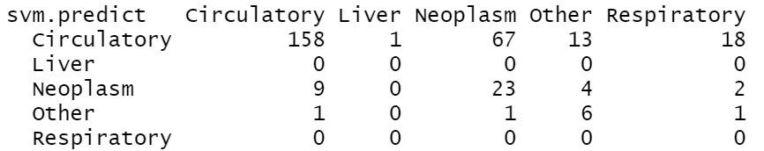
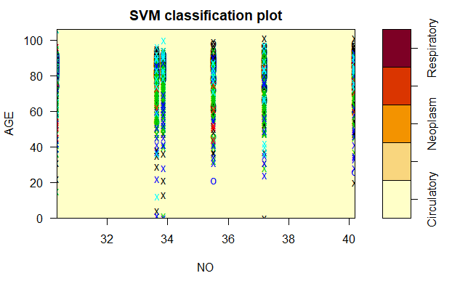
Support Vector Machines
RESULTS:
SVM
Optimal tuning parameters using Cross Validation: cost=10 & Kernel=”radial”
Lowest Classification error on test-set: 38.49%
Classification Accuracy(SVM) : ~ 62 %
Notes:
The cost and the kernel corresponding to the lowest error above is the one chosen by our cross-validation model, i.e, cost of 10 with kernel "radial". Now that we know the best tuning parameters, we applied that to training and testing data to get the classification accuracy rate.*

Slide 7
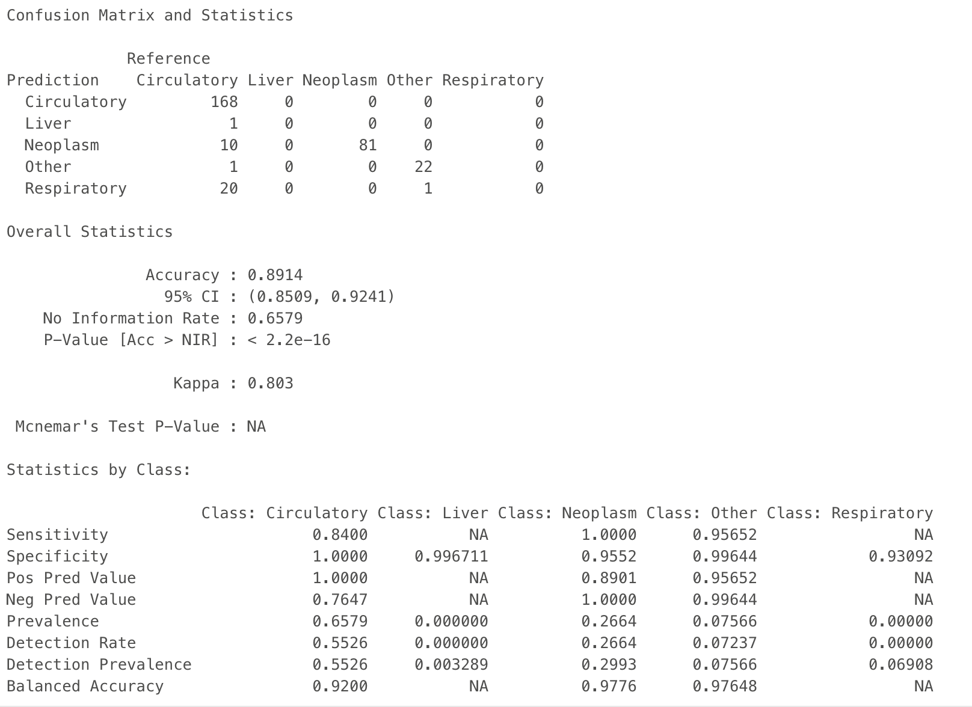
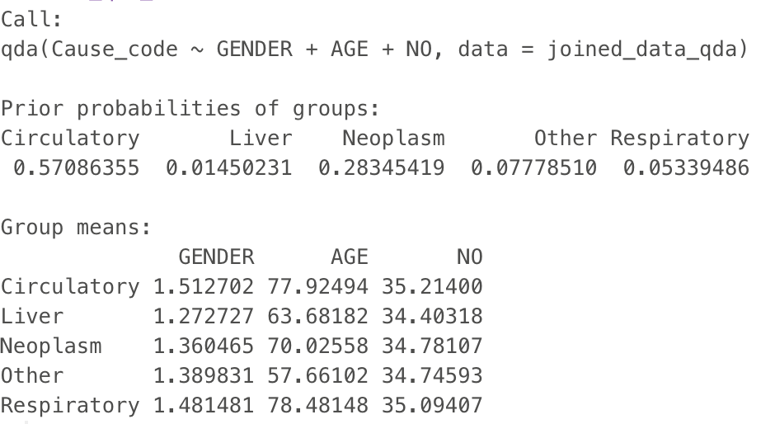
LDA & QDA
RESULTS: LDA
Classification Accuracy (LDA) : 89.14%
Classification Accuracy (QDA)*: Rank Deficiency issue
RESULTS: QDA
Notes:
Used variable selection for QDA due to rank deficiency because of multicollinearity in the data

Slide 8
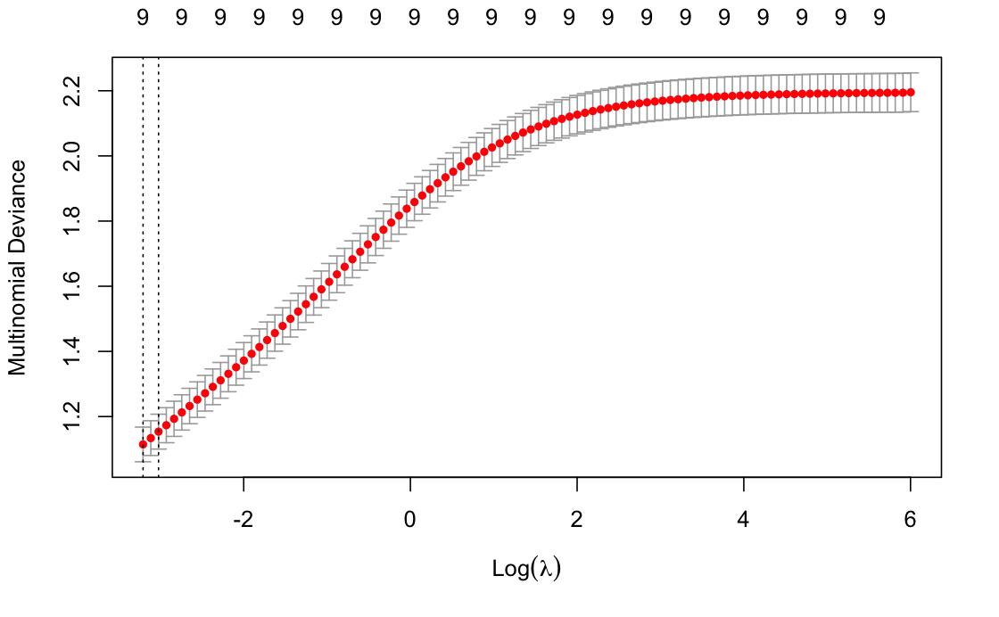
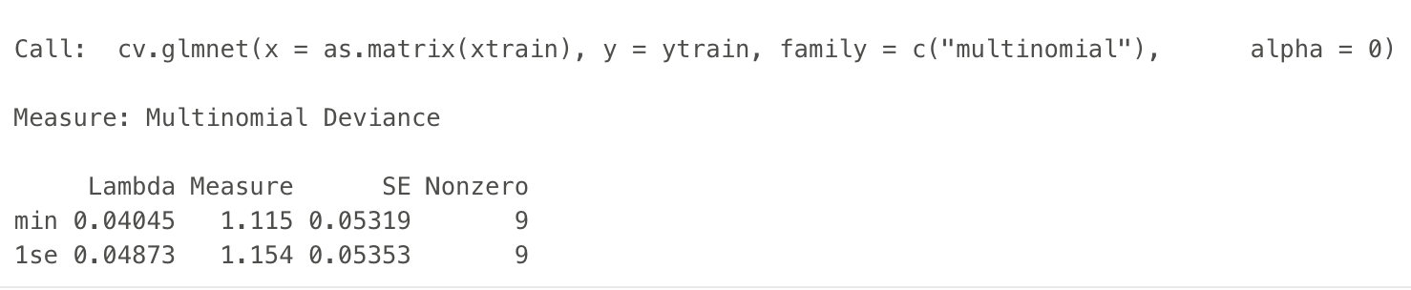
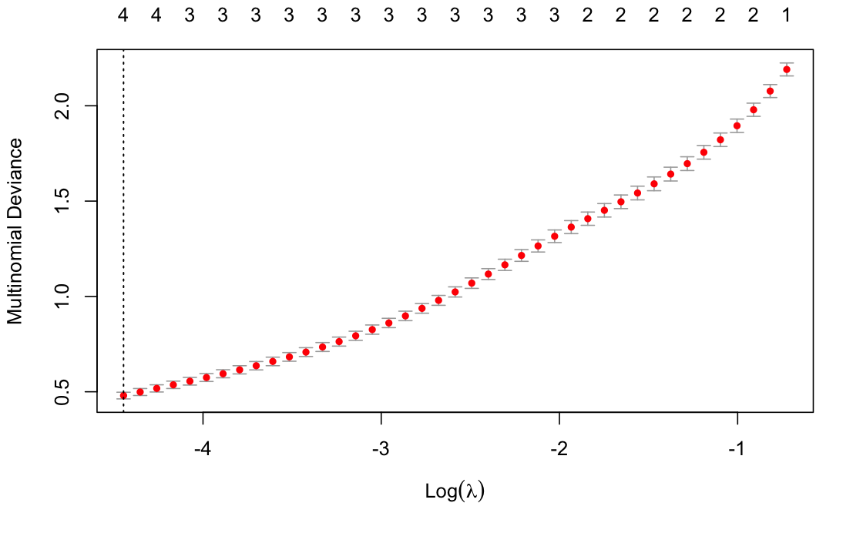
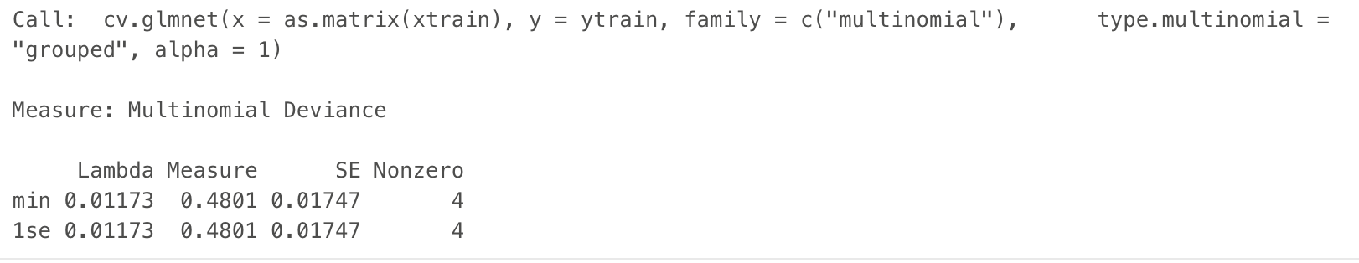
Shrinkage Methods: LASSO & Ridge
RESULTS: RIDGE
RESULTS:
LASSO
Reducing the problem of Multicollinearity
Classification Accuracy (Ridge): 84.5%
Classification Accuracy (LASSO): 90.13%

Slide 9
DISCUSSION & NEXT STEPS
Improve Classification Accuracy by:
Oversampling to improve the imbalanced proportion of data in classes
Use other methods like PCA, Deep Learning and Neural Networks
Solve multicollinearity issue by building separate models for each pollutant
Improve Interpretability by:
Well separating the feature “AREA”. Aspropirgos is very small.
Additional variables with environmental data from Aspropirgos to establish relation between climate change factors and pollutants on mortality causes
Notes:
Class imbalance: More precise classification in terms of mortality cause since codes from ICD 16 were overlapping!!

Slide 10
Thank you!

